Slide 1
The Virtual Reality Design Review Application 2.0
Application Functionality Demands

Slide 2
The end goal for the Application
Modernize and digitalize the design review workflow
Make information more organised by having it present directly in a 3D model
Improve collaboration and communication between designer and approval engineer
E.g by showing them areas of attention in the model during a virtual design review meeting
Keep a history of all the changes made to the design and the 3D model
Make the work done during the design phase more accessible during surveys
Improve 3D perception and interaction with virtual reality- and gesture recognition technology
To enable this, support for several functional areas need to be added.
We are here to discuss which to prioritize.

Slide 3
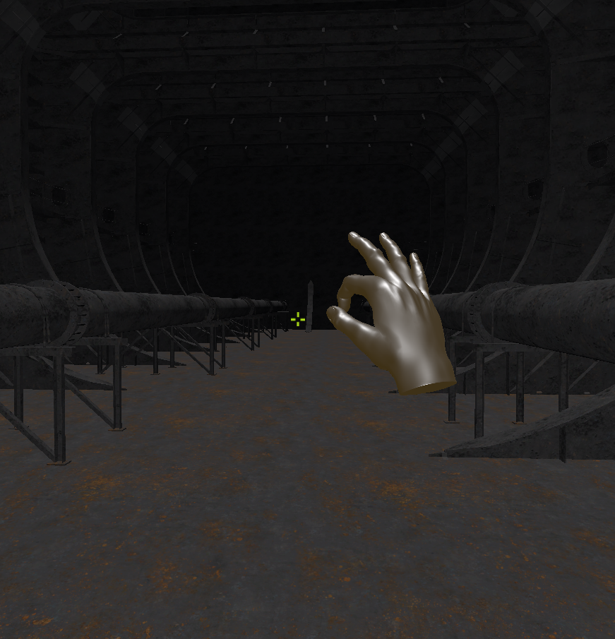
Functionality 1: Navigate a 3D model
To be able to navigate the 3D model in a first-person view using either mouse and keyboard or gestures.
Implemented!

Slide 4
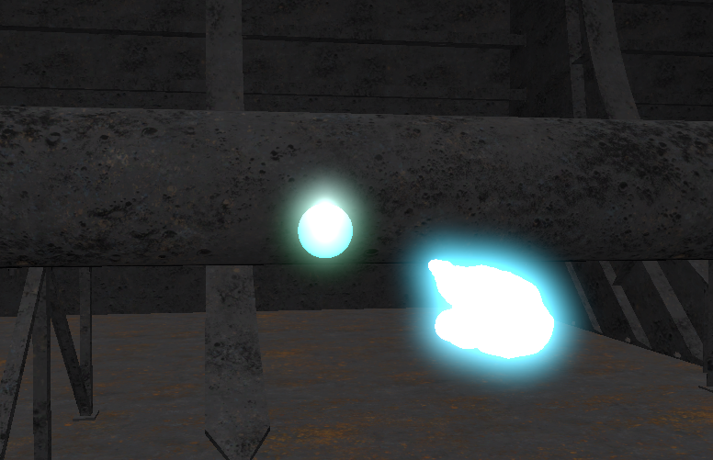
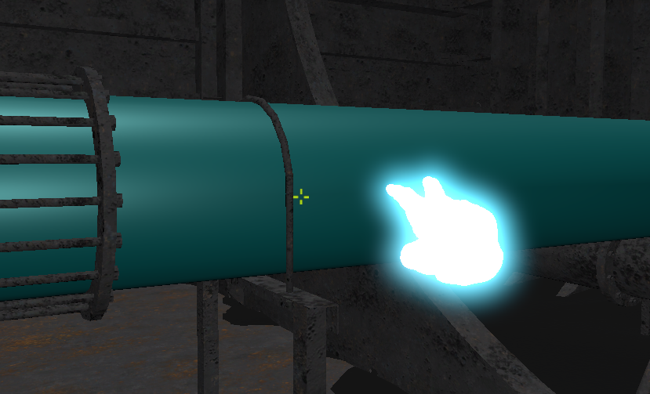
Functionality 2: Create annotation
To be able to create annotations, which can store information related to the annotations position or the object it is attached to.
The user should be able to create either “point-annotations” or “object-annotation”.
Implemented!

Slide 5
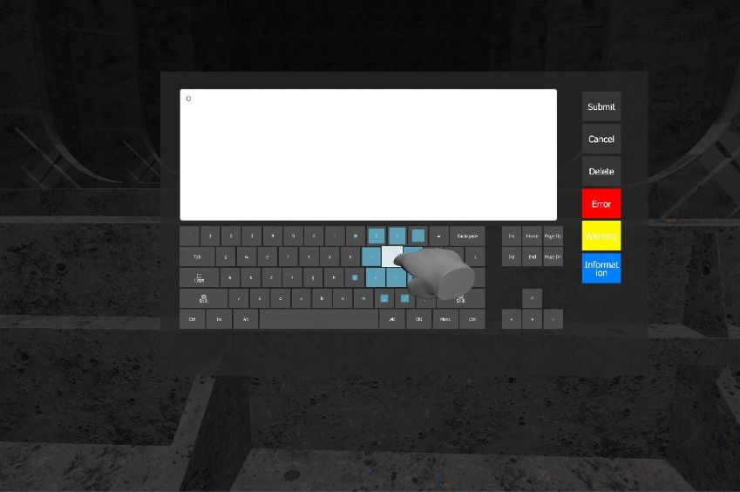
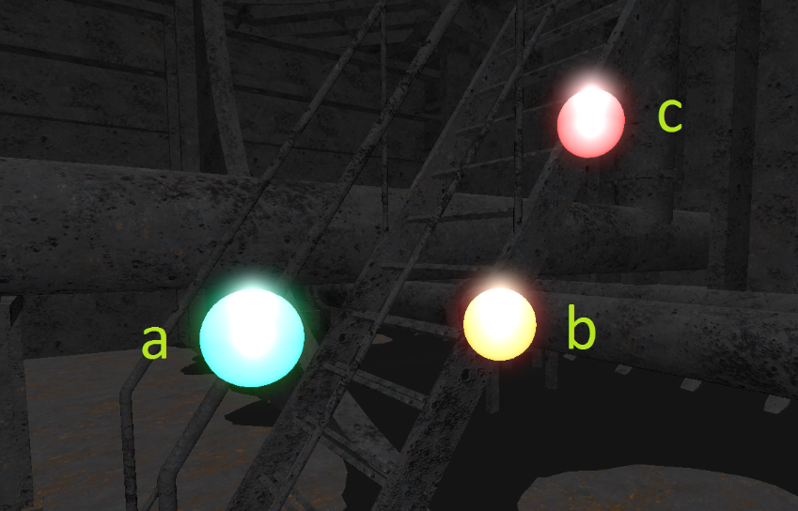
Functionality 3: Edit annotations
To be able to edit the annotations. This should include writing an associated text and setting a priority. The priority should be indicated by colouring the annotation differently.
Although somewhat impractical, edits of annotations should also be possible by only using gestures.
Implemented!

Slide 6
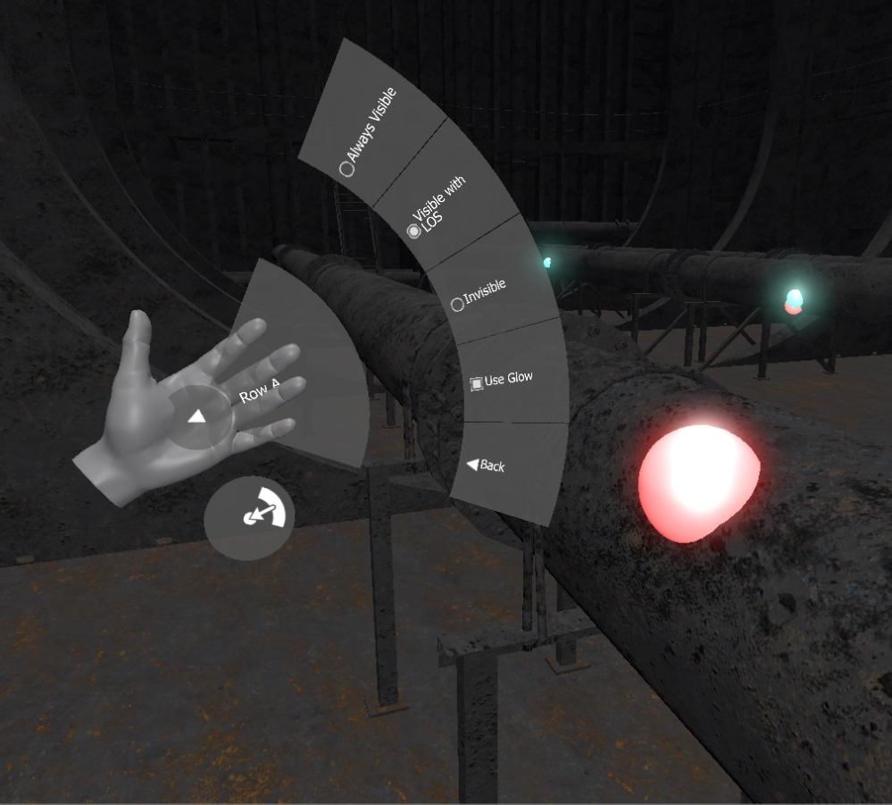
Functionality 4: Enable several options through a menu
To be able to select between several options related to how the applications functions.
Examples of options includes:
Choosing between having separate gesture for movement along the x-, y- and z-axis, or having this combined in one gesture.
Annotation visibility levels
Temporary disable gestures
Implemented!

Slide 7
The way forward
This recaps the functionality that was added during the master’s thesis and, in short, enables a user to move around a 3D model and create basic annotations.
However, to reach our end goal – outlined in our introductory slide – a lot more functionality is needed. In short we need:
To be able to select the 3D model we want to use.
Host a meeting in this model, which enables other users to join the meeting.
Have avatars of the users so they can see each other in the model
Annotations to persist between sessions/meeting (a save and load mechanism)
Expose the annotations in other formats as well (e.g export a list of annotations to a pdf- or doc file).

Slide 8
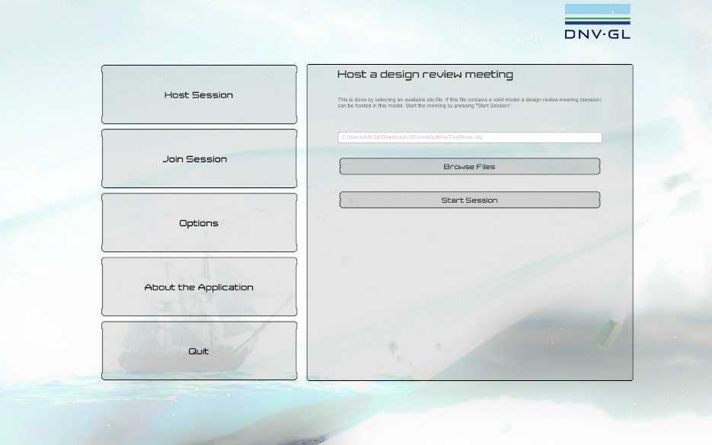
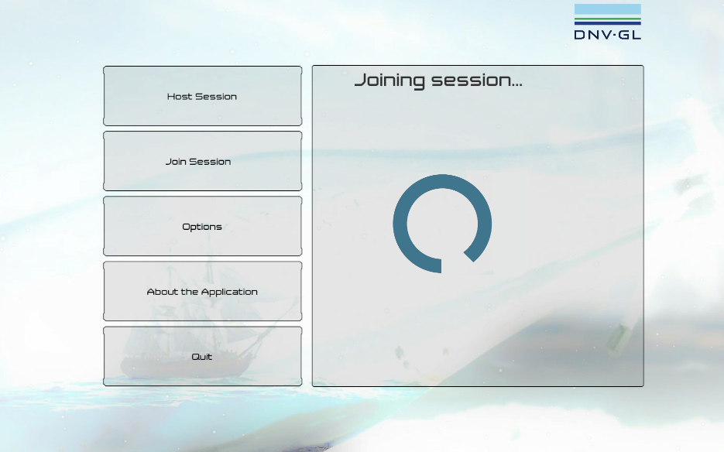
Functionality 5: Selecting the 3D model
The user should be able to specify what model he or she would like to host design review meeting in. This should be done by e.g a file browser where the model is selected.
Once a model is selected the session can be started by pressing “Start Session”.
Implemented!

Slide 9
Functionality 6: Enabling multiple users in a meeting
To enable multiple users to be present in the 3D model we need some network functionality. We can either host the sessions on a dedicated server, or use peer-to-peer- technology, where the host’s computer acts as the server.
The latter is arguably the best to start with as it doesn’t require us to have the application running on a server, and having a dedicated server environment for it.
Estimated development time (one developer): 10 days.

Slide 10
Functionality X: Expose annotation to other platforms
The application should also:
Store/save the annotations “in” the model
Either in a separate file, database or in the model file itself.
Make the annotation accessible outside the model. There are three primary approaches to this:
Generate and export an annotation list to file (e.g. txt, doc(x), pdf or xls)
Relatively simple, but read-only.
Create a web-application where annotations can be viewed and edited (e.g in a scrumboard or an issue tracker)
This enables annotations to be written/filled in outside of the application
Much more time demanding to implement than the former.
Interface with an existing web-application system (e.g Jira or Confluence)
I personality don’t know the difficulties of this.
About as demanding as the former.

Slide 11
Thank you!
Andreas Oven Aalsaunet
andreas.aalsaunet@gmail.com
+47 913 73 741

